Slide 1

Reduced Order and Ensemble Modeling
RAVEN Workshop
PHYSOR 2016 – May 1st 2016, Sun Valley (ID)

Slide 2
Outline
RAVEN models: brief overview
Reduced Order Modeling
Brief introduction
When we can apply them
ROMs and RAVEN
Ensemble Modeling
Application examples of Reduced Order and Ensemble Modeling

Slide 3
RAVEN models: overview

Slide 4
RAVEN models: a quick introduction
RAVEN categorizes in its Models entity the following sub-entities:
Codes:
Aimed to interface with physical codes (e.g. RELAP5-3D, etc.)
ROMs:
Aimed to emulate the response of a system based on a simplified mathematical representation
External Models:
Aimed to provide to the user an easy way to implement sets of equations directly in RAVEN
Post-Processors:
Aimed to analyze the generated datasets (e.g. Statistical moments, Data Mining, etc.)
Ensemble Models:
Aimed to assemble multiple models

Slide 5
Reduced Order Modeling

Slide 6
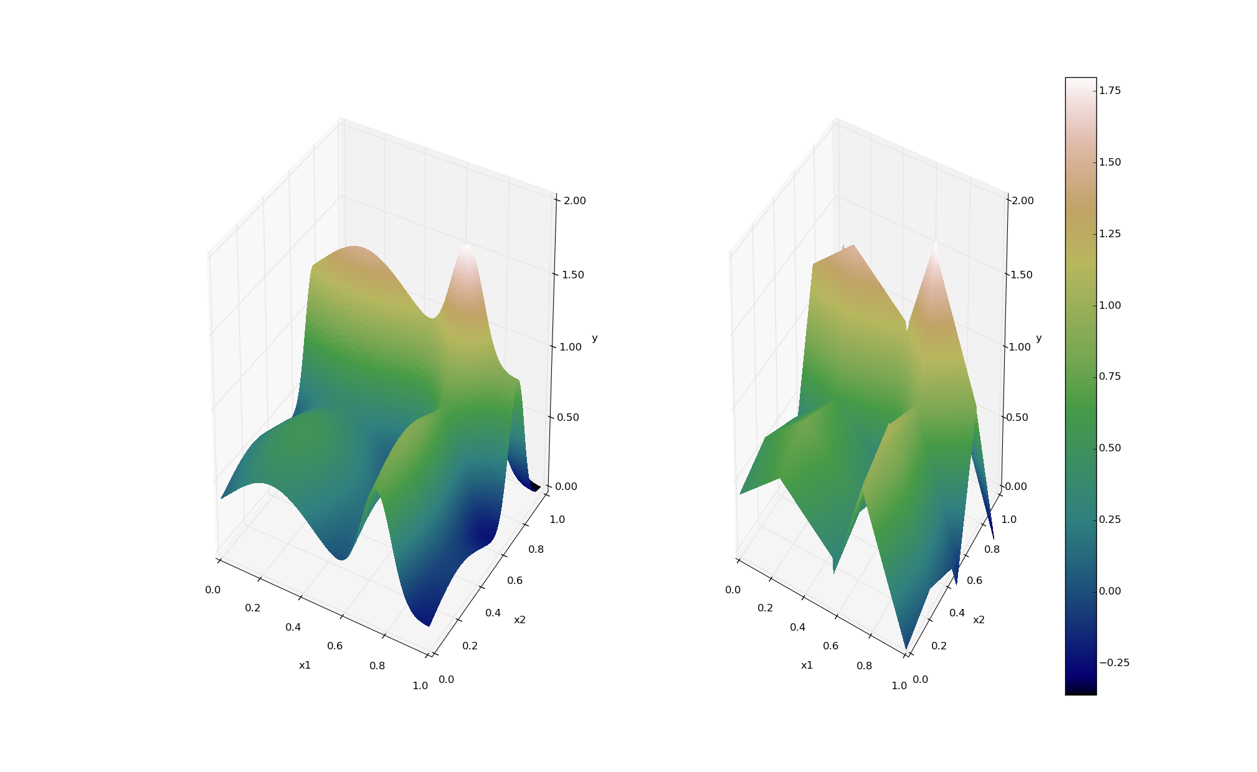
ROMs: a Quick Introduction
Output: Simulation outcome (success/failure, max clad temperature)
Consider a set of N data points
Build a surrogate model
Reduced Order Model
DataObjects
(PointSet)
Inputs: Initial and boundary conditions
≅

Slide 7
ROMs: a Quick Introduction
Basically we are trying to reduce the complexity of the original model
Pros:
Much faster computation of the output variable
Cons:
Presence of error in the ROM computed values
ROM (e.g., quadratic regressor)
≅
Original data (e.g., RELAP5)

Slide 8
Classes of ROMs
Model-Based
Prediction is performed using a blend of interpolation and regression algorithms
Examples:
Gaussian Process Models (GPMs)
Spline interpolator
Data-Based
Prediction is performed by solely considering the input data by using data searching algorithms
Examples:
Nearest neighbor

Slide 9
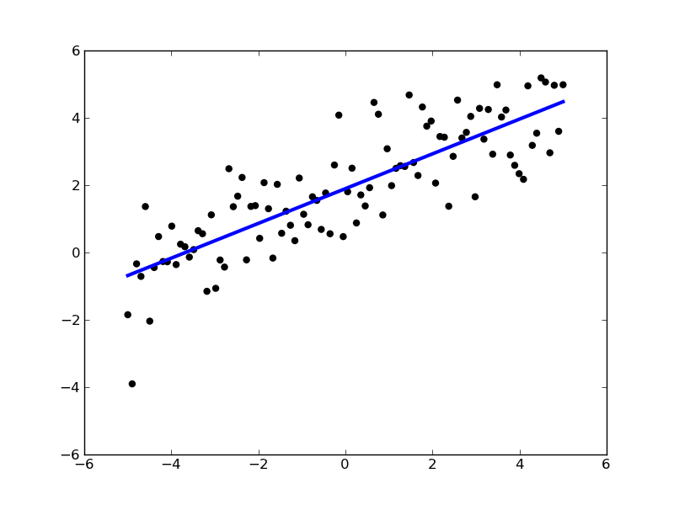
ROMs: Applications
Basic steps:
Sample original model
Train the ROM
Perform desired analysis with the ROM
instead of the original model
Range of applications:
Uncertainty quantification / Sensitivity analysis
Probabilistic Risk Analysis (PRA)
Accelerator for stochastic analysis (adaptive sampling)
Prediction models
Output y
Input x

Slide 10
ROMs Available in RAVEN
External libraries: Scikit-learn (http://scikit-learn.org)
Open source machine learning library for Python
Library for data mining and data analysis
Built on NumPy and SciPy
Internally C++ developed libraries: CROW
Generalized Polynomial Chaos (subject of a later presentation)
Multi-dimensional interpolators
ND Spline
ND Inverse-Weight

Slide 11
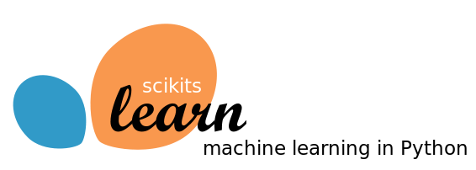
Scikit-Learn Library
Available:
Classification: identifying to which category an object belongs
Regression: predicting a continuous-valued attribute
Data clustering: grouping similar objects into sets
Dimensionality reduction: reducing the number of random variables
Data pre-processing: feature extraction and normalization
Examples:
Linear regression models
Support Vector Machines
Multi-Class classifiers
Naïve Bayes
Neighbors classifiers
Tree classifiers
Notes:
Add backup slides for some algorithms GPM and SVM

Slide 12
Scikit-Learn Library
Classification
Starting point: set of data points with labels
[features, class]_{i}
Objective: identify which class a new point [features] belong
Clustering
Starting point: set of data points
[features]_{I}
Objective: group data points based on a specific distance metrics
Y
(μ₁,σ₁²)
(μ₂,σ₂²)
X
Notes:
Add backup slides for some algorithms GPM and SVM

Slide 13
Scikit-Learn Library
Starting point: set of data points
[features]_{i}
Cardinality reduction
Objective: identify the most relevant features that keep data points unique
Outcome: Location of the points on the reduced space (e.g., line)
Regression
Objective: estimate the relationships among variables via a statistical process
Outcome: coefficients of the reduced space (e.g., m and c for linear interpolator )
Source: scikit-learn.org
Notes:
Add backup slides for some algorithms GPM and SVM

Slide 14
Multi-Dimensional Interpolators
CROW: Internally developed C++ library
Interpolation on any dimension
Response surface is created as an interpolation function given a set of data points defined on:
Sparse grid
Cartesian grid
Extension of the known 1-D interpolation schemes

Slide 15
Multi-Dimensional Interpolators
Two classes of algorithms
Inverse-Weight
No interpolation kernel is defined
Defined on sparse grid
Multi-Dimensional Spline
Defined on cartesian grid
Based on multi-dimensional spline kernel
Continuity of the derivative is preserved
where:

Slide 16
RAVEN reduced order modeling: examples

Slide 17
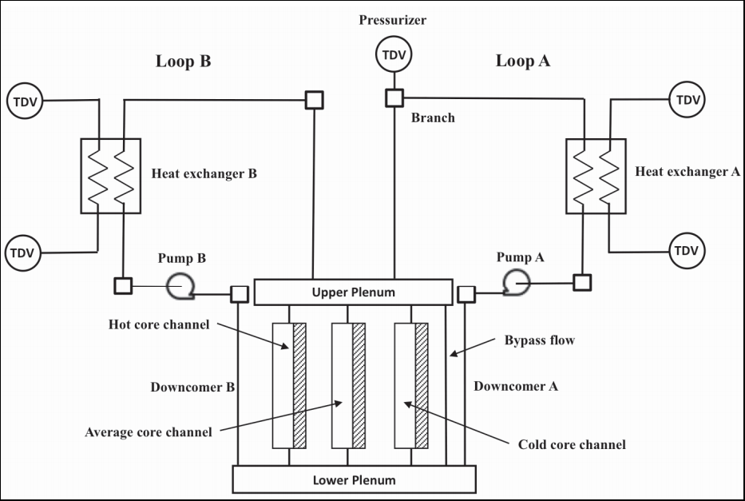
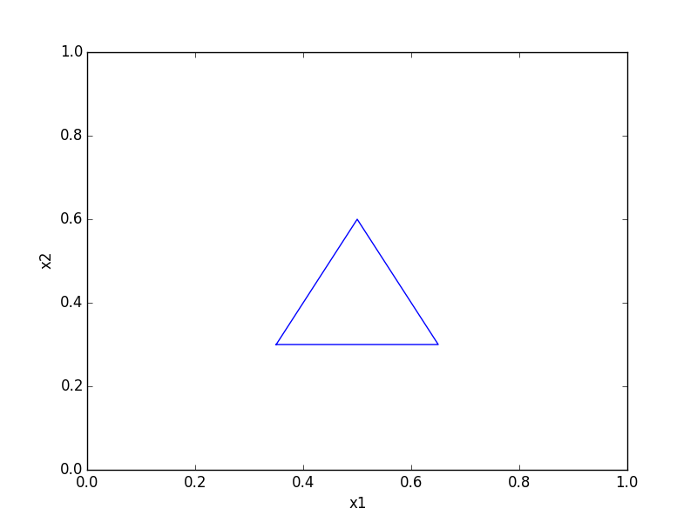
Test cases
Surrogate Models chosen:
Support Vector Machines (SVM)
K Nearest Neighbors (KNN)
Test cases:
PWR system; LOOP + SBO scenario
DG failure time
PG recovery time
2 analytical cases
1 discontinuous test case

Slide 18
PWR SBO Test case: SVM
Initial training samples
Initial estimate of the limit surface
1
30
60
185
Iteration

Slide 19
Discontinuous Test case: KNN
Initial training samples
1
Initial estimate of the limit surface
150
450
675
Iteration

Slide 20
Comparison Criteria
Initial conditions
Fixed value for probability convergence criteria: 1.0 E-4
Identical initial training points
Observe for each ROM (KNN and SVM)
Number of samples required
Error of probability value within limit surface boundaries

Slide 21

Results
PWR SBO
Multiple Regions
Discontinuous
 | # iterations | error
SVM | 270 | 3.45 E-4
KNN | 328 | 3.10 E-3
 | # iterations | error
SVM | 645 | 4.11 E-3
KNN | 675 | 8.69 E-2
 | # iterations | error
SVM | 199 | 3.54 E-2
KNN | 556 | 4.50 E-3

Slide 22
RAVEN ensemble modeling

Slide 23
Ensemble Model
A new model entity (e.g., class), named EnsembleModel, has been developed:
Assemble multiple models of other categories, identifying the input/output connections and the order of execution
Notes:
Sometimes, multiple models need to interface with each other since the initial conditions of some are dependent on the outcomes of others

Slide 24
Ensemble Model: Chain of Models
Model 1
Model N-1
Model N
Model 2
Model 1
Model 3
Notes:
Sometimes, multiple models need to interface with each other since the initial conditions of some are dependent on the outcomes of others

Slide 25
Ensemble Model: Non Linear
Notes:
Sometimes, multiple models need to interface with each other since the initial conditions of some are dependent on the outcomes of others

Slide 26
RAVEN ensemble modeling: 3 simple examples

Slide 27

Ensemble Model: Example 1
1-Dimensional heat conduction transient (in a slab of thickness L=1 m):
EM1, heat conduction partial differential equation:
EM2, thermal conductivity (input of EM1) as function of the average temperature in the slab boundary conditions:
EM2
EM1

Slide 28
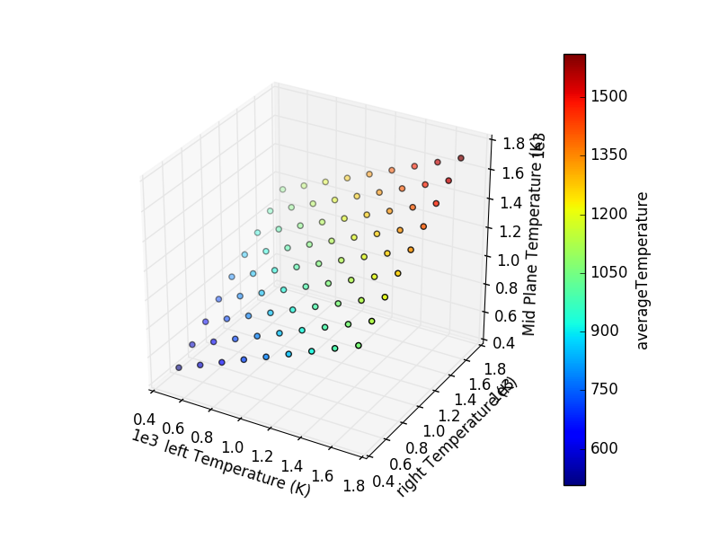
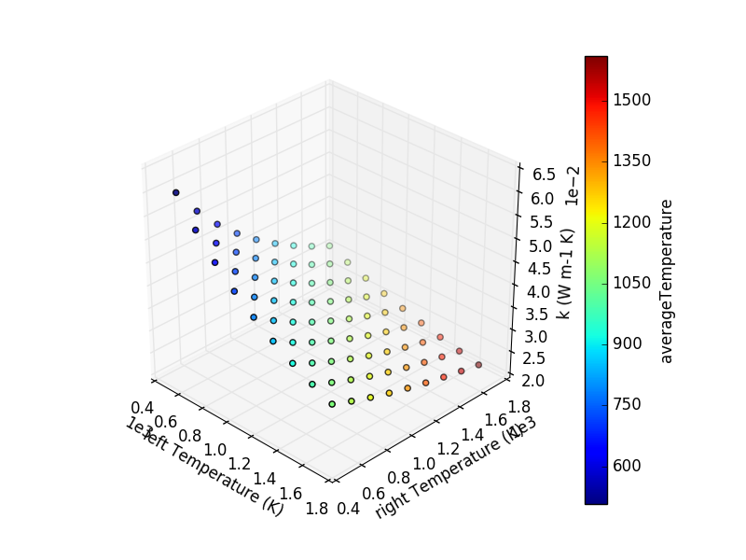
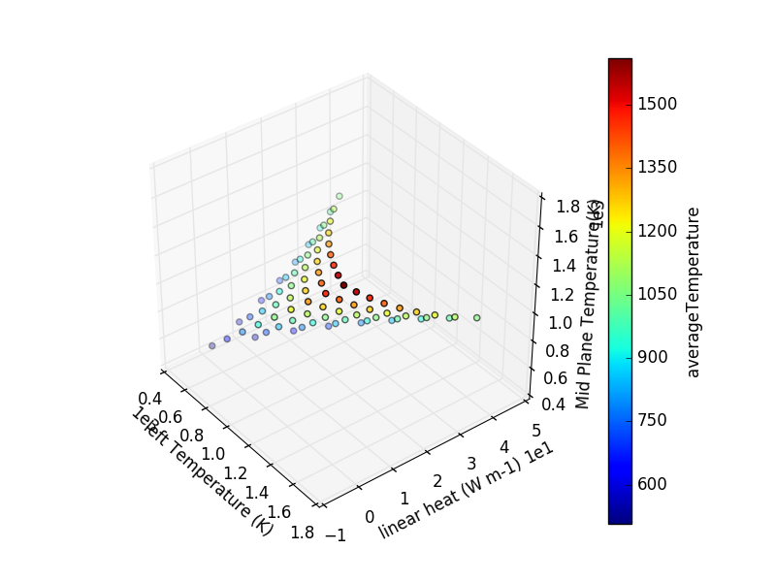
Ensemble Model: Example 2
1-Dimensional heat conduction transient (in a slab of thickness L=1 m):
EM1, heat conduction partial differential equation:
EM2, thermal conductivity (input of EM1) as function of the average temperature in the slab (solution):
EM1
EM2

Slide 29
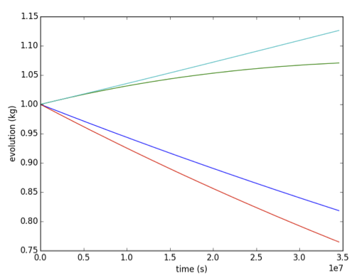
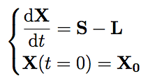
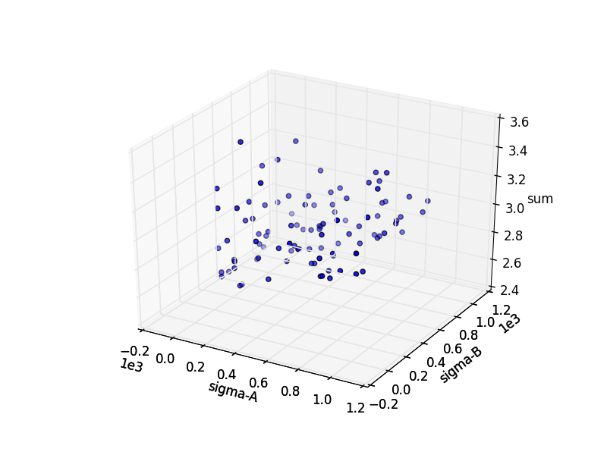
Ensemble Model: Example 3
Also codes can be used in the Ensemble modeling.
EM1: Code, Analytical Bateman
Transmutation
EM2: External Model, compute the sum of the final outcomes of EM1
EM1
EM2

Slide 30
RAVEN Examples

Slide 31
RAVEN examples: ROMs

Slide 32
ROM Modeling Within RAVEN
All modeling steps that involve ROMs are available in RAVEN
Create ROMs from a database
Perform statistical analysis using ROMs

Slide 33
Exercise 1: Create a ROM

Slide 34
Workflow
Sample model
Create database
Train a ROM
Sample a ROM
Stat Analysis
Input File name: ROM_example.xml

Slide 35
Sample a Model and Create a Database
Distributions
Models
Samplers
Databases
DataObjects
OutStreams
Steps
<Distributions>
<Uniform name=’uni'>
<upperBound>1.0</upperBound>
<lowerBound>0.0</lowerBound>
</Uniform>
</Distributions>
Distribution specifications

Slide 36
Sample a Model and Create a Database
Distributions
Models
Samplers
Databases
DataObjects
OutStreams
Steps
<Models>
<ExternalModel name=’attenuation' subType=’’ ModuleToLoad=’poly’>
<variables>
y1,
y2,
ans
</variables>
</ExternalModel>
<ROM name=’a_ROM' subType=’NDinvDistWeight’>
<Features>
y1,y2
</Features>
<Targets>
ans
</Targets>
<p>
3
</p>
</ROM>
</Models>
Input variables
File name:
poly.py
Output variables
Input Space
Output Space
ROM parameters

Slide 37
Sample a Model and Create a Database
Distributions
Models
Samplers
Databases
DataObjects
OutStreams
Steps
<variable name>
<distribution>
<grid points>
<Samplers>
<Grid name='Grid_sampler'>
<variable name=’y1' >
<distribution>uni</distribution>
<grid type='value’ construction='equal' steps='5'>0.0 1.0</grid>
</variable>
<variable name=’y2' >
<distribution>uni</distribution>
<grid type=’CDF’ construction='equal' steps='5'>0.0 1.0</grid>
</variable>
</Grid>
</Samplers>

Slide 38
Sample a Model and Create a Database
Distributions
Models
Samplers
Databases
DataObjects
OutStreams
Steps
<Databases>
<HDF5
name='out_db’
readMode=’overwrite’
/>
</Databases>
<DataObjects>
<PointSet name=’outGRID'>
<Input>y1,y2</Input>
<Output>ans</Output>
</PointSet>
<PointSet name=’outGRID_from_db'>
<Input>y1,y2</Input>
<Output>ans</Output>
</PointSet>
<PointSet name=’outGRID_ROM'>
<Input>y1,y2</Input>
<Output>ans</Output>
</PointSet>
<PointSet name='inputPlaceHolder'>
<Input>y1,y2</Input>
<Output>OutputPlaceHolder</Output>
</PointSet >
</DataObjects>
<DataObjects>
<Input>
<Output>
Overwrite or update?

Slide 39
Sample a Model and Create a Database
Distributions
Models
Samplers
Databases
DataObjects
OutStreams
Steps
<OutStreams>
<Print name=’out_dump'>
<type>csv</type>
<source>outGrid</source>
</Print>
<Plot name=’plotResponse’ dim=’3’ >
<plotSettings>
<plot>
<type>scatter</type>
<x>outGRID|Input|y1</x>
<y>outGRID|Input|y2</y>
<z>outGRID|Output|ans</z>
</plot>
</plotSettings>
<actions>
<how>screen,png</how>
</actions>
</Plot>
</OutStreams>
CSV or XML
2D or 3D
Which DataObject we want to print?
Plot Type
x y z variables
Output format

Slide 40
Sample a Model and Create a Database
Distributions
Models
Samplers
Databases
DataObjects
OutStreams
Steps
<Steps>
<MultiRun name=’sampleModel'>
<Input class='DataObjects' type=’Point' >inputPlaceHolder</Input>
<Model class='Models' type='ExternalModel’>attenuation</Model>
<Sampler class='Samplers' type='Grid' >Grid_sampler</Sampler>
<Output class='DataObjects’ type=’PointSet’ >outGRID</Output>
<Output class='Databases' type='HDF5' >out_db</Output>
<Output class='OutStreams' type='Print' >out_dump</Output>
<Output class='OutStreams' type='Plot' >plotResponse</Output>
</MultiRun>
<IOStep name=’extractDatabase'>
<Input class='Databases' type='HDF5' >out_db</Input>
<Output class='DataObjects’ type=’PointSet’ >outGRID_from_db</Output>
</IOStep>
…
(cont. in next slide)
…
</Steps>

Slide 41
Sample a Model and Create a Database
Distributions
Models
Samplers
Databases
DataObjects
OutStreams
Steps
<Steps>
…
(cont. from previous slide)
…
<RomTrainer name=’trainROM'>
<Input class='DataObjects’ type=’PointSet’ >outGRID_from_db</Input>
<Output class='Models' type=’ROM’ >a_ROM</Output>
</RomTrainer>
<MultiRun name=’sampleROM'>
<Input class='DataObjects' type=’Point' >inputPlaceHolder</Input>
<Model class='Models' type='ROM’ >a_ROM</Model>
<Sampler class='Samplers' type='Grid' >Grid_sampler</Sampler>
<Output class='DataObjects’ type=’PointSet’ >outGRID_ROM</Output>
<Output class='OutStreams' type='Plot' >plot_ROM_LS</Output>
</MultiRun>
</Steps>

Slide 42
Workflow
Sample model Create database
sample_Function.xml
Train a ROM
Sample ROM
sample_ROM.xml

Slide 43
Train and Sample a ROM
Distributions
Models
Samplers
Databases
DataObjects
Steps
<Distributions>
<Normal name='normal_trunc'>
<mean>0.5</mean>
<sigma>0.1</sigma>
<lowerBound>0.0</lowerBound>
<upperBound>1.0</upperBound>
</Normal>
<Normal name='normal'>
<mean>2.0</mean>
<sigma>0.2</sigma>
</Normal>
<Uniform name='uniform'>
<upperBound>4.0</upperBound>
<lowerBound>1.0</lowerBound>
</Uniform>
</Distributions>
Truncation parameters
Input file name: sample_ROM.xml

Slide 44
Train and Sample a ROM
Distributions
Models
Samplers
Databases
DataObjects
Steps
<Models>
<ROM name='ROM4' subType='NDinvDistWeight'>
<Features>x1,x2,x3</Features>
<Target>y4</Target>
<p>3</p>
</ROM>
</Models>
Multi-dimensional interpolator (CROW)
Input file name: sample_ROM.xml

Slide 45
Train and Sample a ROM
Distributions
Models
Samplers
Databases
DataObjects
Steps
<Samplers>
<Grid name=’Grid_ROM'>
<variable name='x1'>
<distribution>normal_trunc</distribution>
<grid type='value' construction='equal' steps='10’>0.0 1.0</grid>
</variable>
<variable name='x2’>
<distribution>normal</distribution>
<grid type='value' construction='equal' steps='10’>1.5 2.5</grid>
</variable>
<variable name='x3’>
<distribution>uniform</distribution>
<grid type='value' construction='equal' steps='10'>1.0 4.0</grid>
</variable>
</Grid>
</Samplers>
Finer grid
Input file name: sample_ROM.xml

Slide 46
Train and Sample a ROM
Distributions
Models
Samplers
Databases
DataObjects
Steps
<Databases>
<HDF5 name='out_db' filename='out_db.h5' directory='path2DB/DBStorage/'/>
</Databases>
<DataObjects>
<TimePointSet name='outGRID_y4'>
<Input>x1,x2,x3</Input>
<Output>y4</Output>
</TimePointSet>
<TimePointSet name='outROM_y4'>
<Input>x1,x2,x3</Input>
<Output>y4</Output>
</TimePointSet>
<TimePointSet name='Data1'>
<Input>x1,x2,x3</Input>
<Output>OutputPlaceHolder</Output>
</TimePointSet>
</DataObjects>
Database containing training dataset
Training DataObject
ROM generated DataObject
Input file name: sample_ROM.xml

Slide 47
Train and Sample a ROM
Distributions
Models
Samplers
Databases
DataObjects
Steps
<Steps>
<IOStep name='extract_data4'>
<Input class='Databases' type='HDF5' >out_db</Input>
<Output class='DataObjects' type='TimePointSet' >outGRID_y4</Output>
</IOStep>
<RomTrainer name='rom_trainer4'>
<Input class='DataObjects' type='TimePointSet' >outGRID_y4</Input>
<Output class='Models' type='ROM' >ROM4</Output>
</RomTrainer>
<MultiRun name=’RunRom4'>
<Input class='DataObjects’ type='TimePointSet’ >Data1</Input>
<Model class='Models' type=’ROM’ >ROM4</Model>
<Sampler class='Samplers' type='Grid' >Grid_ROM</Sampler>
<Output class='DataObjects’ type='TimePointSet' >outROM_y4</Output>
</MultiRun>
</Steps>
Input file name: sample_ROM.xml

Slide 48
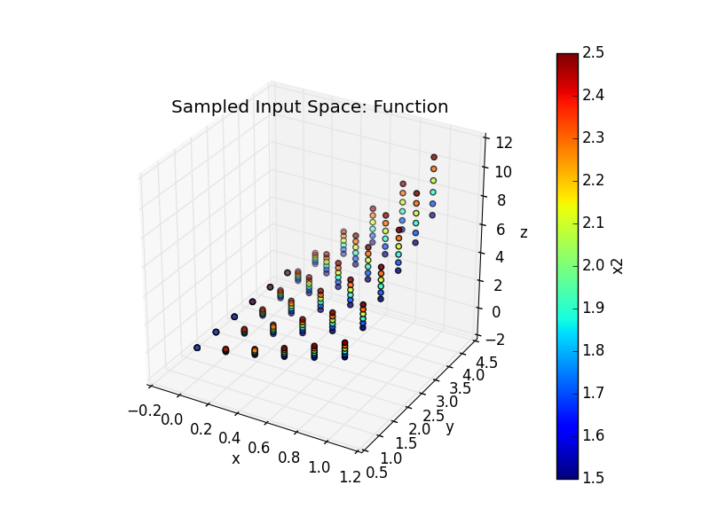
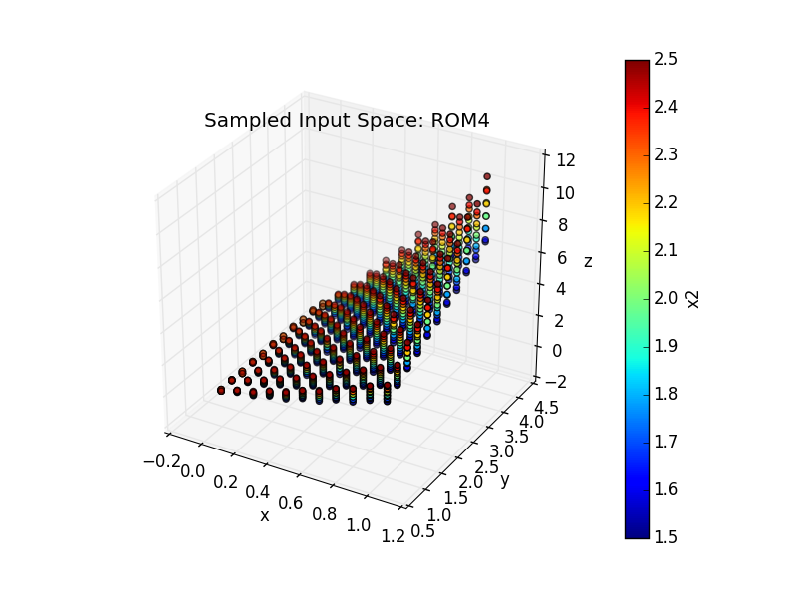
Train and Sample a ROM
Output: y₃
Inputs: x₁, x₂, x₃

Slide 49
Thank you Questions?

